Slide 1

Department of Artificial Intelligence and Machine Learning
FinSight — An Agentic AI Based Financial Research & Analysis System
Kishanthraja M 231501077
Raguchanthar 231501126
Mervin Anto Santhosh A 231501099
Dr.M.Soundarya

Slide 2
Problem Statement and Motivation
Financial research requires information from multiple sources such as financial reports, market data, company filings, and news.
Manual financial analysis is time-consuming and makes it difficult to efficiently combine and compare information from different sources.
Traditional LLM and basic RAG systems may provide incomplete or unsupported insights because retrieval is generally fixed and does not adapt to the research requirement.
Need: An intelligent financial research system that plans research tasks, retrieves relevant evidence, analyzes financial information, validates its findings, and provides reliable insights with human oversight.

Slide 3
User and Stakeholder Analysis
Financial Researchers / Analysts – Quickly gather and analyze information about companies and markets.
Investors / Decision Makers – Understand financial performance, opportunities, and potential risks.
Students / Researchers – Perform structured financial research using multiple reliable sources.
Expected Outcome
Generate evidence-backed financial research reports with financial insights, market information, risk analysis, and supporting sources.

Slide 4
Proposed agentic AI solution
FinSight is a multi-agent AI system that automates financial research and analysis.
Planner Agent – Understands the user query and breaks it into research tasks.
Financial Research Agent – Retrieves and analyzes financial reports, filings, and company information.
Market Data Agent – Retrieves market data and performs relevant calculations.
News & Sentiment Agent – Retrieves relevant news and analyzes market sentiment.
Risk Analysis Agent – Identifies financial, market, competitive, and regulatory risks.
Synthesis Agent – Combines the findings into a structured financial research report.
Critic Agent – Verifies evidence and identifies unsupported or incomplete findings.

Slide 5
Dataset and knowledge source identification
Financial Reports & Company Filings
Source: SEC EDGAR / Company Investor Relations
Annual reports, quarterly reports and financial statements
Market & Financial Data
Source: Alpha Vantage APIs
Historical prices, volume and financial indicators
Knowledge Sources
Company filings and financial reports
Regulatory disclosures
Financial news and industry reports
Company announcements

Slide 6
Selection of tools and Framework
Database & Vector Store
SQLite / PostgreSQL – Stores user queries, workflow state, and report history
ChromaDB – Stores and retrieves financial document embeddings
AI Model
GPT-4 / QWEN (pick per availability) – Generates agent reasoning and report synthesis
Agent Frameworks
LangChain – RAG, tool integration, retrievers
LangGraph – Multi-agent workflow, state management, HITL checkpoints
Sentence Transformers(all-MiniLM-L6-v2) – Text embeddings for document chunks

Slide 7
Selection of tools and Framework
Data & Tool Sources
SEC EDGAR / Company filings – Financial document ingestion
Financial APIs (Alpha Vantage) – Market/stock data
News/Search APIs – Recent developments and industry news
Deployment
Next.js 14 + React 18 + TypeScript + Tailwind CSS – Interactive research interface for user queries and reports
FastAPI – Backend API and agent orchestration services
Visualization
Plotly – Interactive market charts and financial trends
Matplotlib – Evaluation graphs (accuracy, hallucination rate, retrieval cost comparisons)

Slide 8
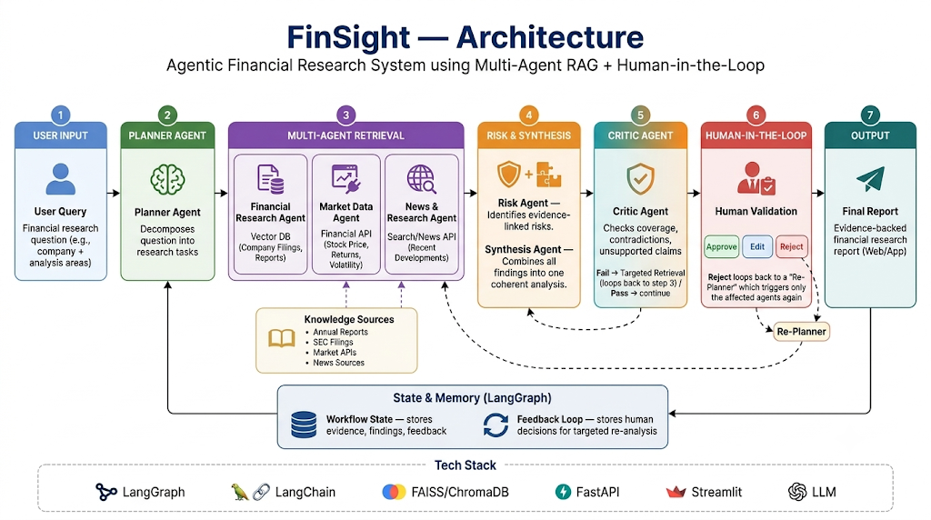
Architecture Diagram

Slide 9
Agent workflow and Orchestration
User Query – User submits a financial research question (e.g., company + analysis areas)
Planning – Planner Agent decomposes the question into research tasks and assigns agents
Multi-Agent Retrieval – Financial, Market Data, and News Agents gather evidence in parallel
Risk Analysis – Risk Agent identifies and evidence-links potential risk factors
Synthesis – Synthesis Agent combines all agent outputs into one coherent analysis
Critic Validation – Critic Agent checks coverage, contradictions, and unsupported claims
Human Validation – User approves, rejects, or redirects specific findings

Slide 10
Agentic RAG
Task Identification – Financial Agent determines what evidence is required (e.g., revenue, cash flow)
Query Generation – Agent creates a targeted retrieval query for the vector DB
Vector Retrieval – Fetches relevant chunks from company filings and reports
Evidence Evaluation – Checks coverage, source quality, recency, and contradictions
Iterative Retrieval – If evidence is insufficient, generates a refined query and retrieves again
Baseline Comparison – Evaluates No-RAG, Basic RAG, and Agentic RAG on accuracy, hallucination rate, and retrieval cost

Slide 11
Human-in-the-Loop (HITL)
AI Findings – System generates key findings with confidence levels (High/Medium/Low)
Human Review – User inspects each finding along with its supporting evidence
Approve – Accepts the finding as-is
Reject – Flags a finding as outdated, wrong, or insufficiently supported, with feedback (e.g., "regulatory source is outdated")
Re-Planning – Re-planner uses the feedback to trigger targeted retrieval on only the affected topic
Targeted Re-analysis – Only the relevant agents (e.g., News → Risk → Synthesis) re-run, not the full pipeline
Final Validation – Human re-reviews the updated finding before the final report is generated

Slide 12
SYSTEM IMPLEMENTATION
Functional Prototype
Research Dashboard – Query formulation and company selection
Multi-Agent Execution – Planning → SEC / Market / News → Synthesis → Verification → HITL
Evidence Trace – SEC chunks, citations and source provenance
HITL Audit Console – Approve, Edit and Reject findings
Executive Dashboard – Verified KPIs and financial trend charts
Final Report – Audited findings, evidence limitations and PDF export

Slide 13
Source-Code Repository
Frontend: Next.js 14, React, Tailwind CSS
Backend: FastAPI, LangGraph
Agents: Planner, Financial Research, Market Data, News, Risk, Synthesis, Verifier, Critic, Replanner
Data: ChromaDB + SEC filings + Alpha Vantage
Evaluation: 49 automated tests + benchmark suite

Slide 14
EXPERIMENTAL EVALUATION
AND RESULTS
Evaluation Metrics
Metric | FinSight Result
Core regression test pass rate | 100% (23/23)
Expanded automated test pass rate | 100% (49/49)
Routing intent accuracy | 100% (5/5)
News relevance test success | 100% (6/6)
Numerical verification tests | 100% (12/12)
Finsight Citation accuracy | 90.0%
Basic RAG citation accuracy | 67.5%
Finsight Hallucination rate | 10.0%
Basic RAG hallucination rate | 32.5%
No-RAG hallucination rate | 42.5%
Testing Methodology
Query → Intent Routing → RAG / Market / News → Verification → Critic → HITL → Final Report
Unit & integration testing
Routing and retrieval testing

Slide 15
News relevance testing
Numerical verification
Performance
Apple: ~22.4 s
NVIDIA: ~24.1 s
Microsoft: ~21.8 s
13 LLM calls/run
Key Result:
FinSight achieved 90% citation accuracy and reduced hallucination to 10%, compared with 67.5% / 32.5% for Basic RAG.

Slide 16
COMPARISON
COMPARISON WITH BASELINES
Capability | No-RAG | Basic RAG | FinSight
Evidence Grounding | ❌ | ✓ | ✓ Agentic
Query Decomposition | ❌ | Limited | ✓
Numerical Verification | ❌ | Limited | ✓
News Filtering | ❌ | Basic | ✓
Quality Control | ❌ | Basic | ✓ Fail-Closed
Human Review | ❌ | ❌ | ✓ HITL

Slide 17
INNOVATION
CORE INNOVATIONS
1. Deterministic Causal Attribution
Separates verified financial figures from unsupported causes
2. Multi-Tier News Relevance Filtering
Rejects irrelevant portfolio/ticker noise
3. Fail-Closed Coverage Ledger
Reports evidence limitations instead of fabricating missing data
4. Human-in-the-Loop Revalidation
Analyst edits are re-verified before publication

Slide 18
CONCLUSION AND FUTUREWORK
Conclusion
FinSight combines agentic research, evidence retrieval, deterministic verification and human oversight to produce auditable and evidence-grounded financial research.
Future Work
Expand financial document corpus
Integrate live SEC data
Improve news-source coverage
Parallelize research tasks
Cloud deployment & multi-user support
Key Takeaway:
From Query → Evidence → Verification → Human Audit → Trusted Research Report

Slide 19
Thank You

